Slide 1
Prism Customer Segmentation
Team Turquoise

Slide 2



Executive Summary
Which customers should we target and How ?
Our two largest customer segments are those of low and medium monetary value who transact infrequently but have transacted in the last 60 to 120 days
Action: Utilise re-engagement email marketing and time-limited discounts for these customers
Customers who have transacted recently (in the last 60 days) should be targeted as they may be more receptive to various marketing tactics due to recent engagement
Action: Utilise personalized recommendations through targeted social media marketing
High-value customers have the potential to significantly enhance gross profit if we expand this segment
Action: Advertise a membership program that rewards high value customers

Slide 3
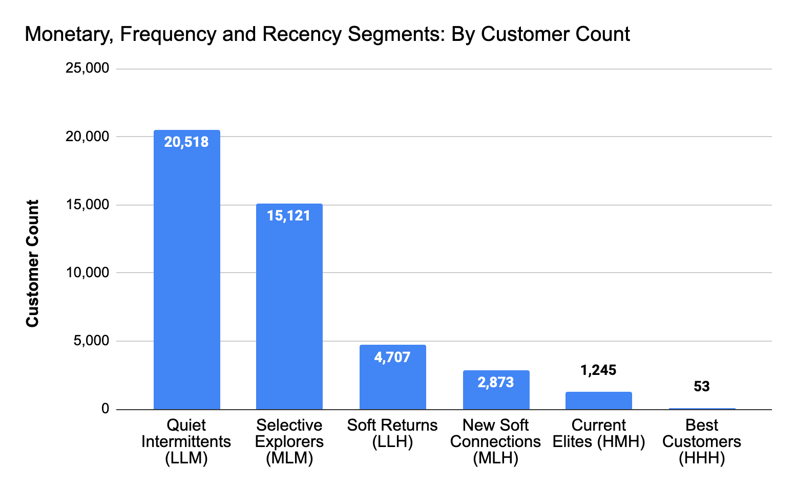
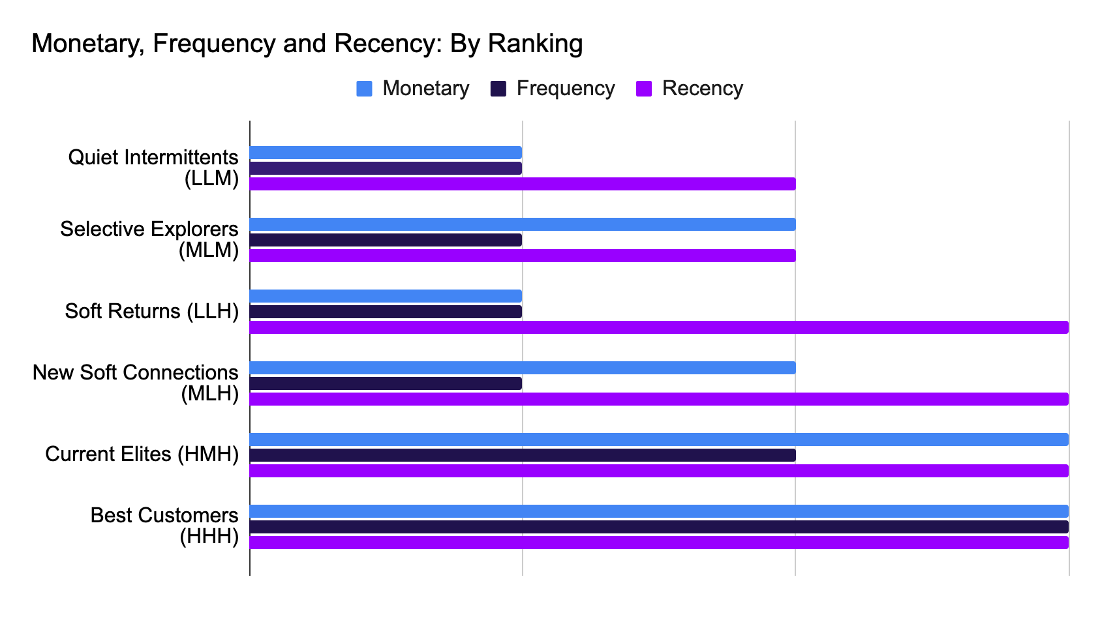
Segment’s with either a high customer count, recent transactors or high monetary value were deemed the most important to Prism
High customer Count
Recent transactors
High monetary
High customer Count
Recent transactors
High monetary
Low
medium
high
*RFM > MFR
These customer segments need to be the focus of Prism’s future marketing strategy

Slide 4
Targeting our top two largest customer segments with the right re-engagement marketing campaign could increase Gross Profit by £55k
Quiet Intermittents (LLM)
20.5k customers
Largest impact
Selective Explorers (MLM)
15.1k customers
Segment Insight
Segment Insight
Low monetary value customers who transact infrequently but have the potential to be revived
Medium monetary value customers who transact infrequently but have the potential to be revived at a higher Gross Profit
Recommendation
Opted in: Send them re-engagement emails with special offers to encourage them to return and make a purchase.
All: Target customers with limited-time discounts such as flash sales
Impact
Impact
If 15% of these customers made a single purchase with a Gross Profit of £5, it would result in £15k additional GP
If 15% of these customers made a single purchase with a Gross Profit of £17.5, it would result in £40k additional GP
Notes:
High 50%
Medium 25%
Low 15%
High £25
Medium £17.5
Low £5

Slide 5
Targeting more ‘receptive’ segments i.e. those who have recently transacted, could increase Gross Profit by £19k
Soft Returns (LLH)
4.7k customers
New Soft Connections (MLH)
2.8k customers
Segment Insight
Segment Insight
Low monetary value customers who transact infrequently but are likely more receptive to marketing as they have recently engaged with us
Medium monetary value customers who transact infrequently but are likely more receptive to marketing as they have recently engaged with us
Recommendation
Opted in: Send marketing emails containing products that compliment their recent purchases
All: Utilise personalized recommendations through targeted social media marketing
+ Push seasonal sales events with discounts on specific product categories or collections
Impact
Impact
If 25% of these customers made a single purchase with a Gross Profit of £5, it would result in £6k additional GP
If 25% of these customers made a single purchase with a Gross Profit of £17.5, it would result in £13k additional GP
Notes:
High 50%
Medium 25%
Low 15%
High £25
Medium £17.5
Low £5

Slide 6
Targeting our ‘best customer’ segments could increase Gross Profit by £19k with minimal effort
Current Elites (HMH)
1.25k customers
Best Customer (HHH)
53 customers
Segment Insight
Segment Insight
High monetary value customers who transact somewhat regularly and are likely more receptive to marketing as they have recently engaged with us
High monetary value customers who transact frequently and are likely more receptive to marketing as they have recently engaged with us
Recommendation
Opted in: Offer them early access to new collections
All: Advertise a membership programme that rewards valuable customers with exclusive offers etc.
Impact
Impact
If 50% of these customers made a single purchase with a Gross Profit of £25, it would result in £16k additional GP
If 50% of these customers made a single purchase with a Gross Profit of £25, it would result in only £1k additional GP

Slide 7
Methodology RFM segmentation

Slide 8
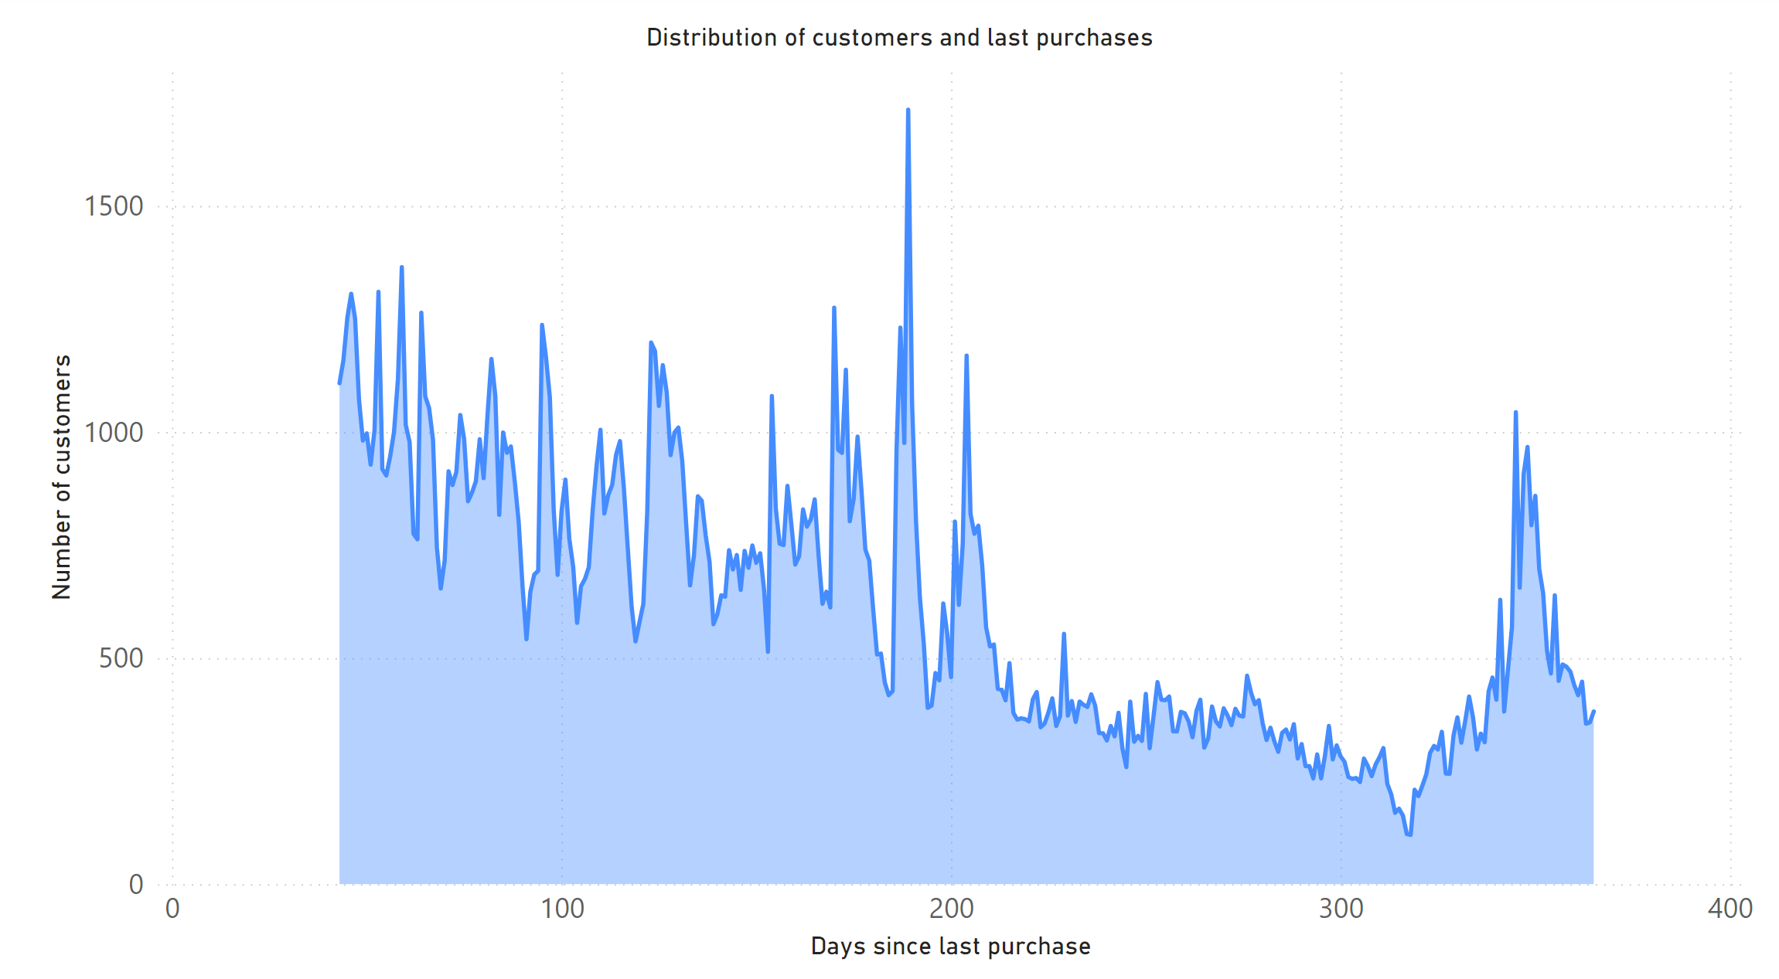
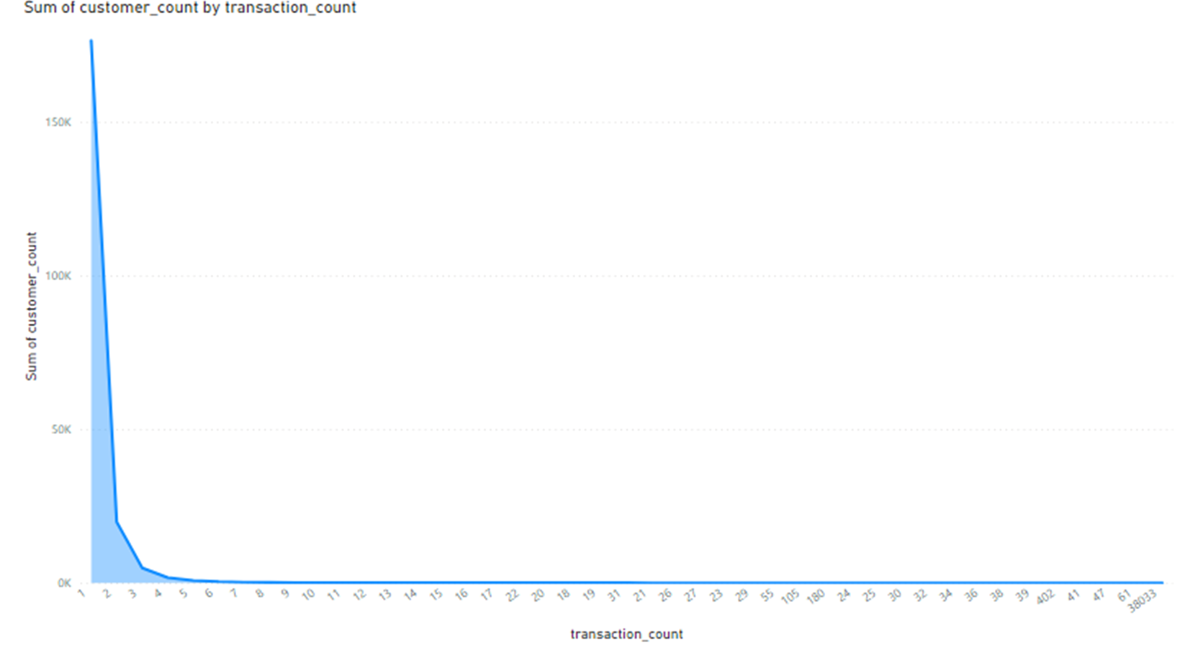
High ‘recency’ customers purchased within the last 60 days, and high ‘frequency’ customers transacted more than 11 times in the last 12 months
Distribution of customer count and recent purchases
Recency
60
days
60-120
days
120+
days
Transacted last 60 days = high ‘recency’ rank (score of 1)
Transacted 60 to 120 days = medium ‘recency’ rank (score of 2)
Transacted 120+ days = low ‘recency’ rank (score of 3)
Number of customers
Days since last purchase
Distribution of customer count and transaction count of
Frequency
1 tnx
2–11
tnx’s
11+
tnx’s
+11 transactions = high ‘frequency’ rank (score of 1)
Between 2 and 11 transactions = medium ‘frequency’ rank (score of 2)
1 transaction = low ‘frequency’ rank (score of 3)
Number of customers
Transaction count

Slide 9
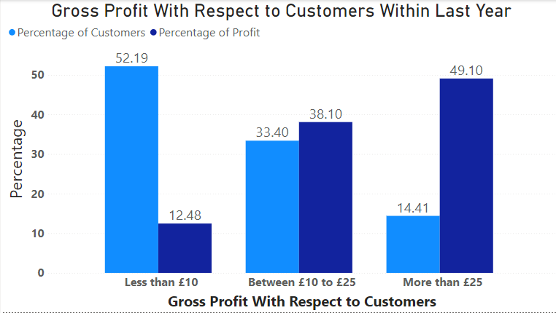
The highest ranked ‘monetary’ customers made up 14% of total customers but contributed to 49% of Gross Profit in the last 12 months
Monetary
More than £25 Gross Profit contribution = high ‘monetary ’rank (score of 1)
Between £10 and £25 Gross Profit contribution = medium ‘monetary’ rank (score of 2)
Less than £10 Gross Profit contribution = low ‘monetary’ rank (score of 3)

Slide 10
Recap
What needs to be done?
Utilise re-engagement email marketing and time-limited discounts for the large cohort of customers who have not transacted recently, but are not completely dormant
Utilise personalized recommendations using targeted social media marketing for customers who have transacted recently
Advertise a membership program that rewards high value customers
Finally, Get more users to opt-in by advertising the benefits of email sign-up i.e. get offers/discounts/new releases first
Future analysis: Calculate average order value and conversion rate for relevant segments for insight into customer behaviour

Slide 11
Thank You

